Slide 1
FlexiVoice
Low-fi Prototyping & Pilot Usability Testing
Esther Goldstein, Rachel Jorgensen, Ron Tep

Slide 2
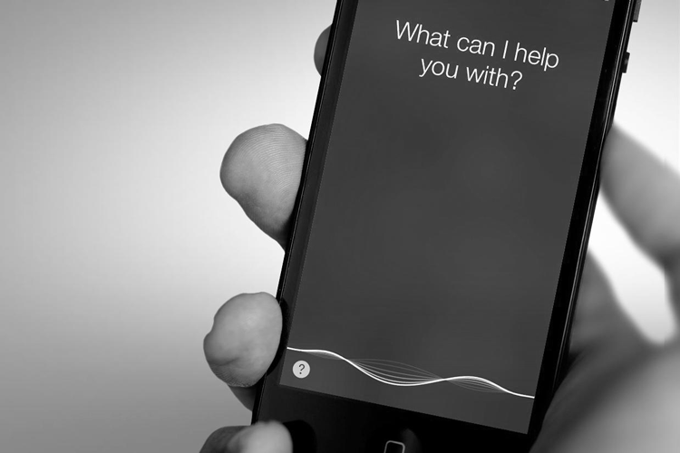
Overview of Talk
Mission and Interface
Prototype and Task Flows
Testing and Results
Suggested Changes and Summary

Slide 3
Mission/Value Proposition
“Make voice interaction work for you!”
Make voice interaction easier to manage, track, and customize
Help guests communicate properly with others’ voice assistants.
Notes:
Value proposition: “Make voice interaction work for you!”
Mission statement: make voice interaction easier to manage, track, and customize for people that own smart devices. In addition, we want people that are visiting others with smart devices to be able to communicate properly with their voice assistants.

Slide 4
Interface and Rationale
Phone app over smart watch
Visual interaction, complex tasks that require many steps
Larger screen, more computing power
Widespread use of smartphones, including interviewees
Group members don’t own a smart watch
Notes:
We chose the phone app as our primary design moving forward. A lot of our tasks require visual interaction, which is not ideal for a smart watch. Smart watches are not really meant for complex tasks that require many steps. Our previous interviews, our participants were using their smartphones to interact with their devices and did not mention smart watches.
While the idea of tracking your location with a smart watch would be helpful, enough people carry their smartphones everywhere, so this should not be a problem. We also thought that for demonstration purposes at the end of the quarter, is would be easier to show an phone app since none of us actually own a smart watch.

Slide 5
Prototype

Slide 6
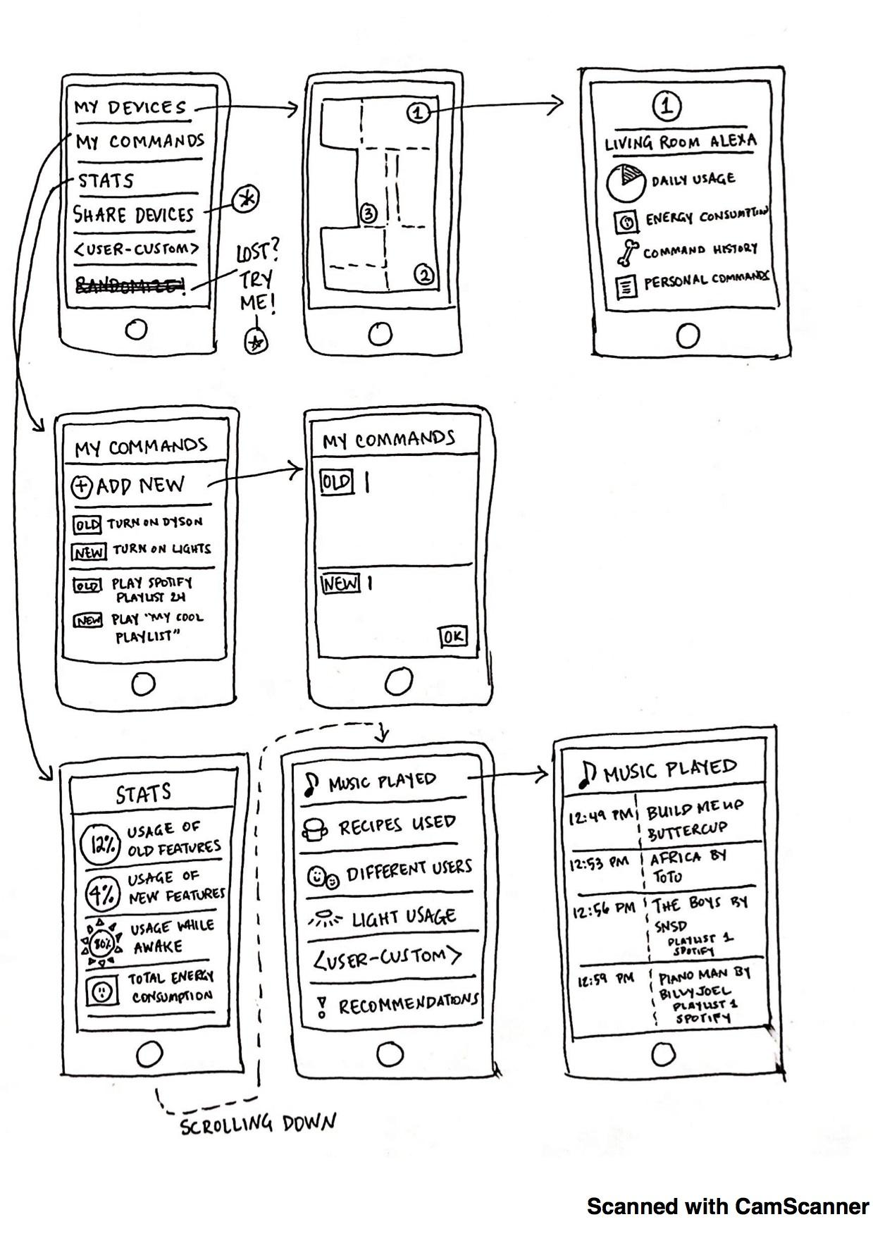
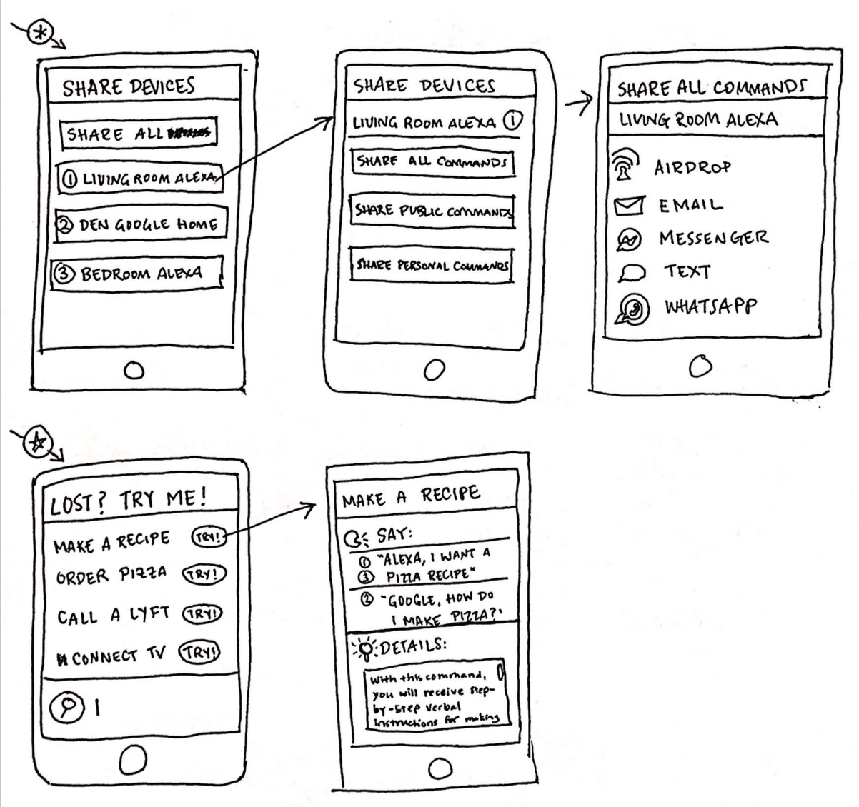
Prototype Structure

Slide 7
Tasks & Task Flows
1. Add a new personalized command to your Google Home, changing it from "Google, turn on my Apple TV" to "Google, turn on my TV"

Slide 8
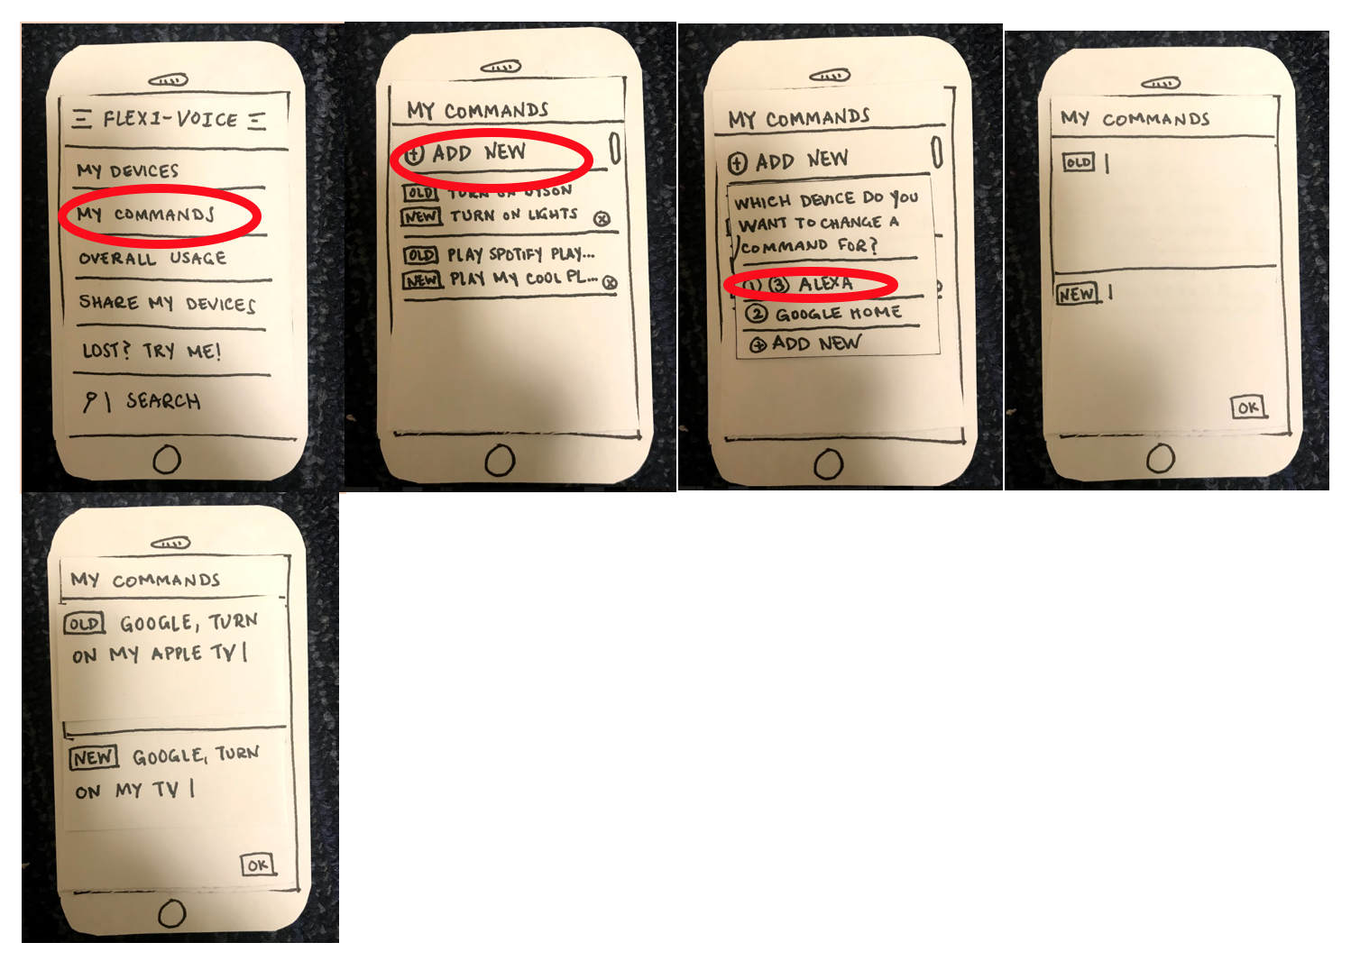
Tasks & Task Flows

Slide 9
Tasks & Task Flows
2. Look up the ingredients in the recipe you used the Living Room Alexa to make last Monday

Slide 10
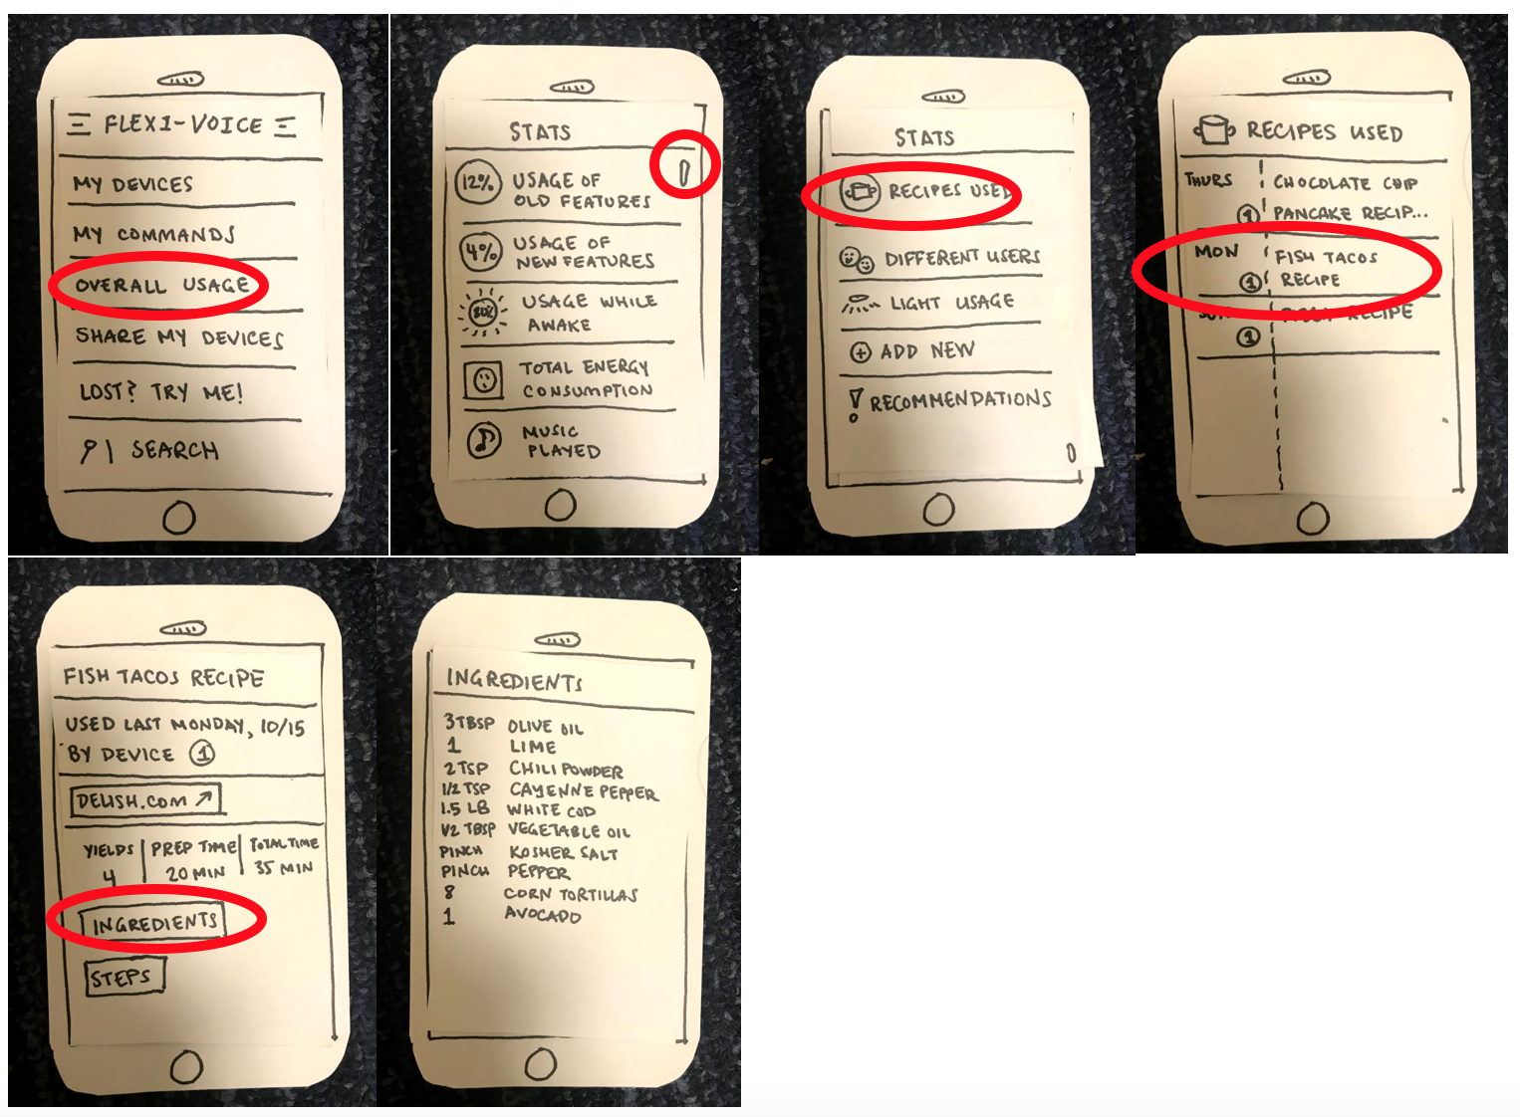
Task & Task Flows

Slide 11
Tasks & Task Flows
3. Text your personalized commands list for the Living Room Alexa to someone named Rachel J

Slide 12
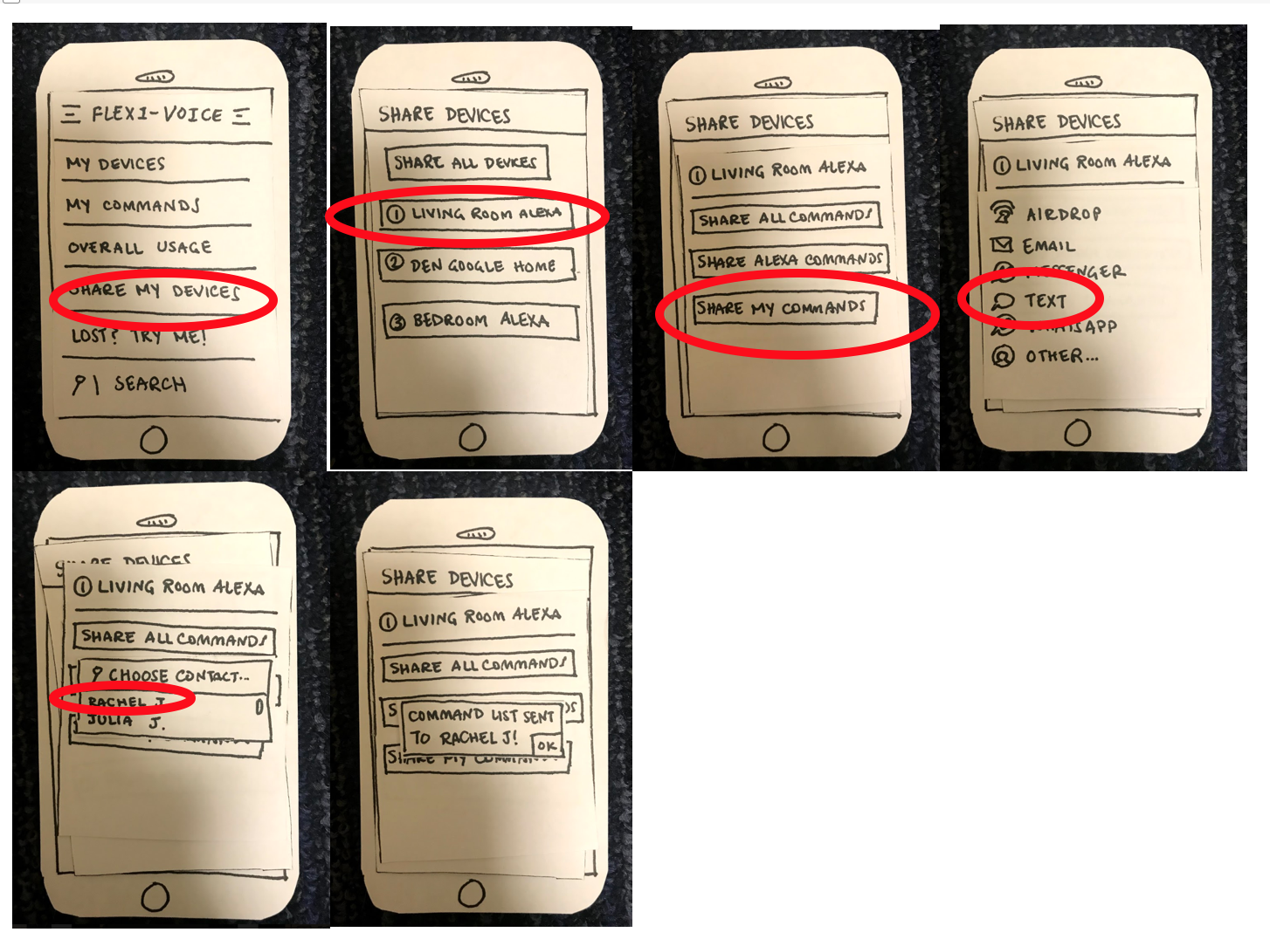
Tasks & Task Flows

Slide 13
Tasks & Task Flows
4. Look up how to call a Lyft

Slide 14
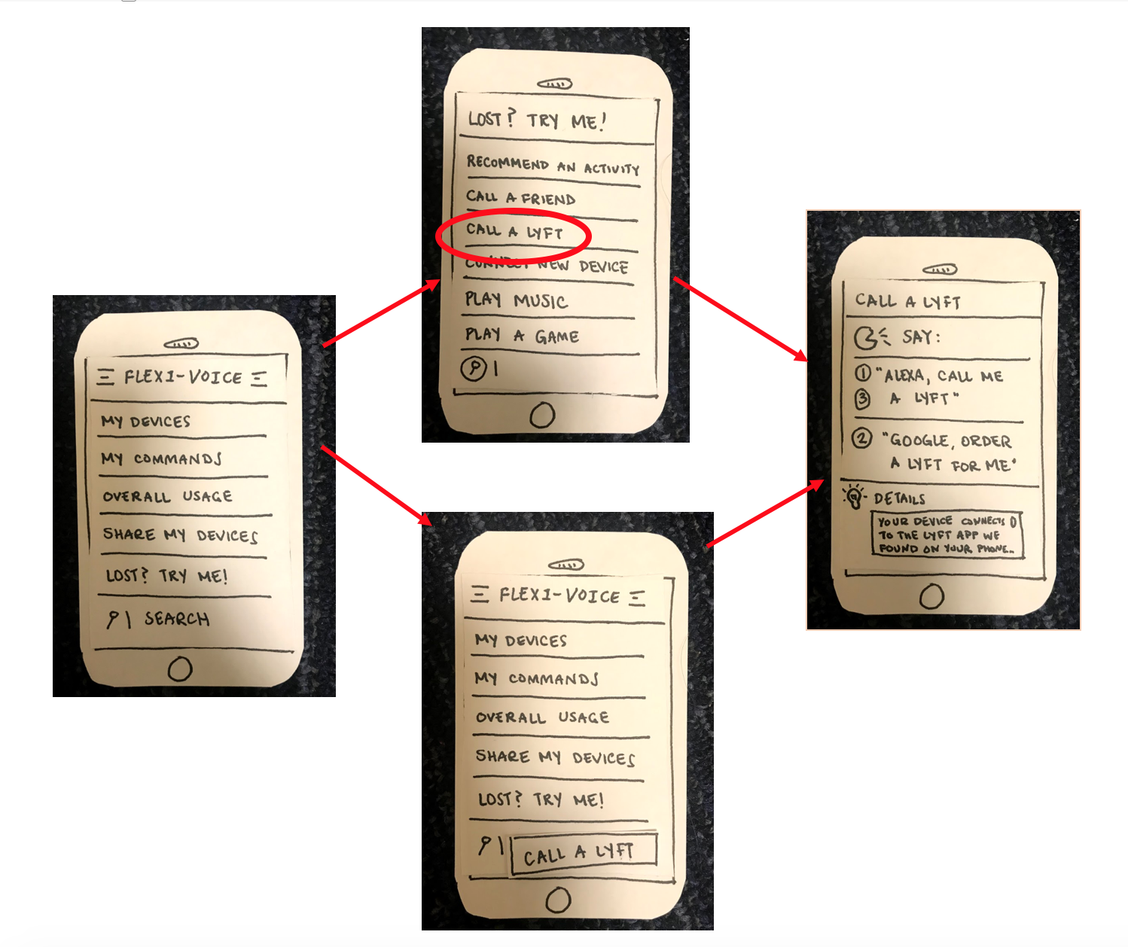
Tasks & Task Flows

Slide 15
Tasks & Task Flows
5. Add a new Google Home to the app and name it "Garage Google"

Slide 16
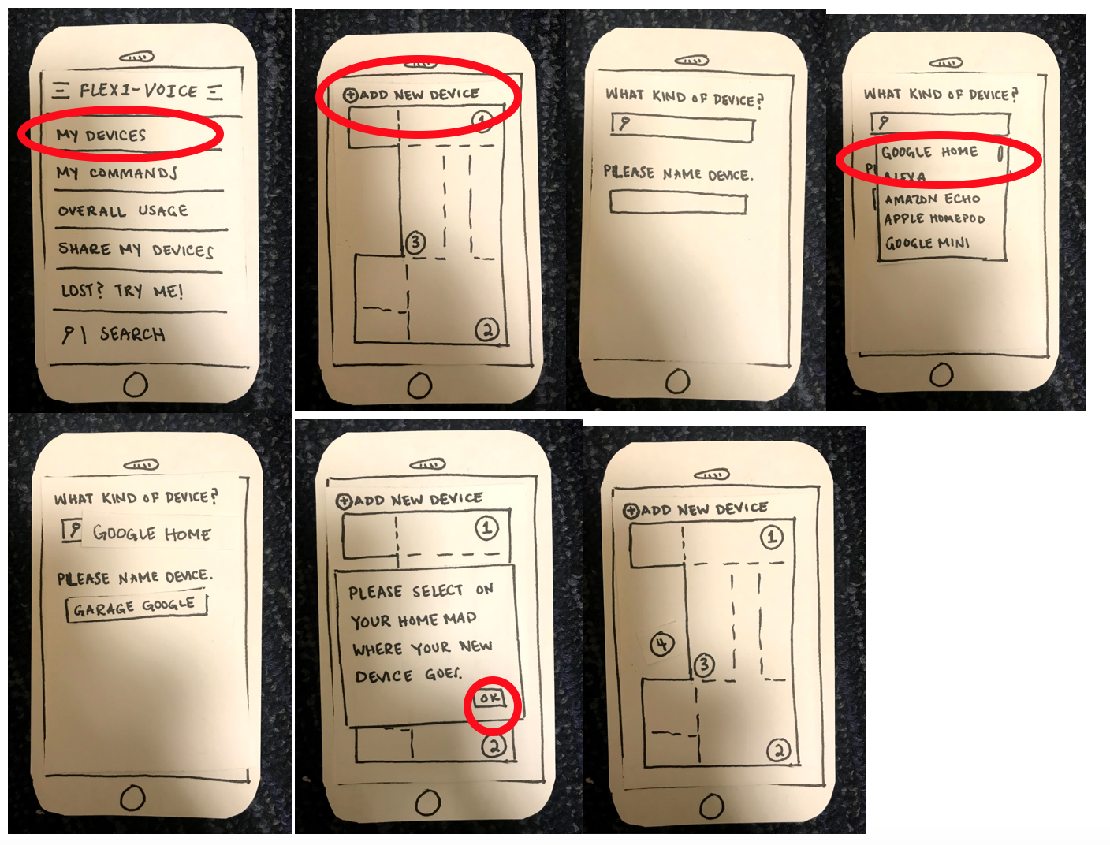
Tasks & Task Flows

Slide 17
Tasks & Task Flows
6. Look up the daily usage for any Living Room Alexa

Slide 18
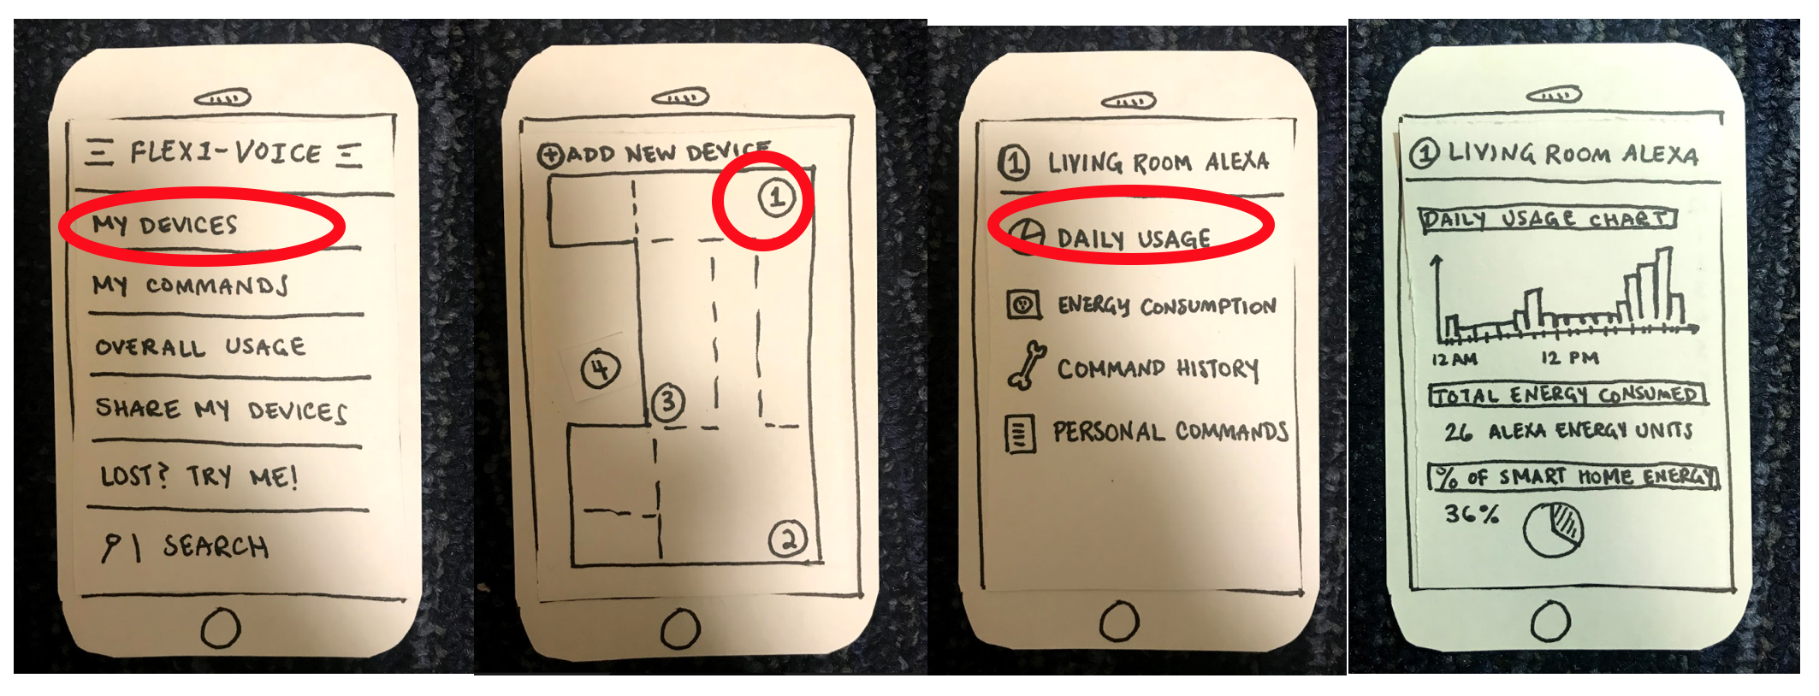
Tasks & Task Flows

Slide 19
Usability Testing

Slide 20
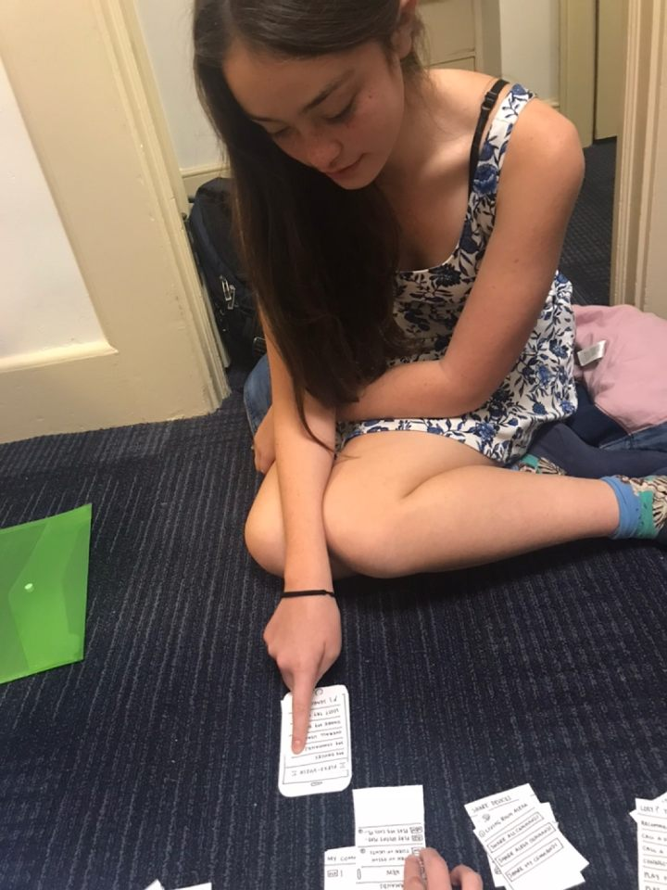
Participants
A retired, former video game market researcher
A retired, former software technical writer
A Stanford undergraduate student
Notes:
Nextdoor
No compensation

Slide 21
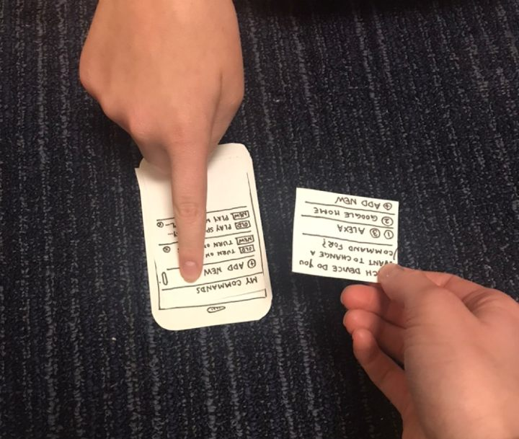
Methods
Procedure:
  Overview of app, consent form, description of task, completion attempt, feedback
Test Measures: ease of use, intuitiveness of the task, whether labels make sense

Slide 22
Results
Overall we received positive feedback
Task 1: Older participants did not understand “command.”
Task 2: Overall Usage is a bit vague; liked Search option
Notes:
1. Add a new personalized command to your Google Home, changing it from "Google, turn on my Apple TV" to "Google, turn on my TV"
-older participants did not understand “command” refers to what they say to their voice assistants.
2. Look up the ingredients in the recipe you used the Living Room Alexa to make last Monday
-Overall Usage is a bit vague and should be called History instead.

Slide 23
Results
Task 3:
  Confused about function of Share My Devices
  Difference between the Alexa Commands and My Commands
Task 4:
  ⅔ completed easily
  Call A Lyft -> button or label?
Notes:
3. Text your personalized commands list for the Living Room Alexa to someone named Rachel J
-. He thought that sharing devices isn’t physically possible, so it should be called share my commands. Participant 2 thought it was a straightforward task, but was confused about the difference between the Alexa Commands and My Commands options
4. Look up how to call a Lyft
-confused if numbers on the Call A Lyft screen were steps instead of numbers representing which device. In addition, she was confused if Call A Lyft is a button or label. Participant 3 clicked on a few wrong screens and then clicked on Lost? Try Me because she was unsure of where to look for the Call a Lyft instructions.

Slide 24
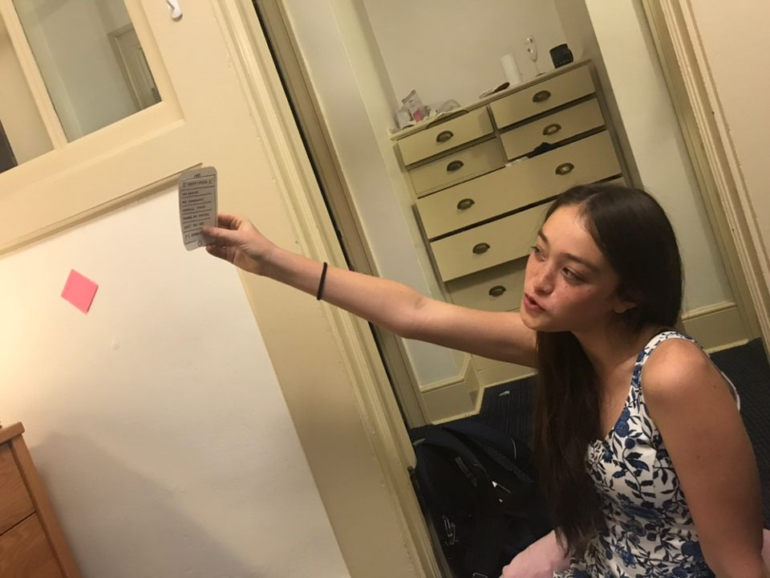
Results
Task 5:
  All initially clicked on the map
  Couldn’t find garage
Task 6:
  All clicked on Overall Usage
  Didn’t realize specific usage in My Devices
Notes:
5. Add a new Google Home to the app and name it "Garage Google"
For Task 5, all participants initially clicked on the map because they thought they could add a device that way. Participants 1 and 2 could not find the garage, and Participant 1 suggested that we put labels on map and allow the user to click on part of the map.
6. Look up the daily usage for any Living Room Alexa
For Task 6, all participants initially clicked on Overall Usage. They weren’t sure which option to click on within that, and they eventually realized that they needed to click on the living room Alexa within My Devices to get to the daily usage.

Slide 25
Suggested UI Changes
Overall Usage -> History
Unclear meaning of Command -> Glossary
Click Add New Device -> Click room on map
Share My Devices -> Share My Commands
Better indicate button vs. label

Slide 26
Summary
Goal: help people be flexible in smart device interaction
Phone app with tasks for sharing devices, calling a Lyft, checking usage, etc.
Results: some labels vague; map screen unclear

Slide 27
Questions?

